Slide 1
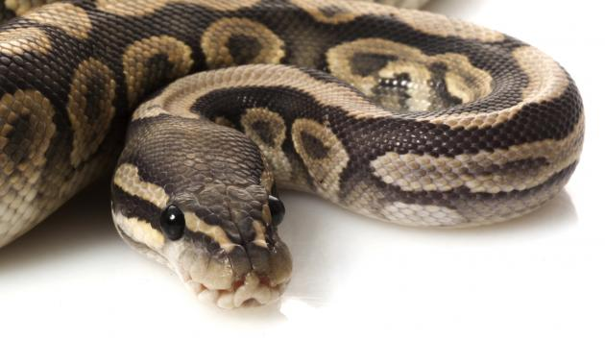
Week 3
Introduction to Programming with Python

Slide 2

Repetition
In order to repeat statements, we can use the for or the while statement
Syntax
for line
repeated instructions in a block

Slide 3
Repetition
for x in [1, 2, 3, 5, 7]:
print(x * “hi”)
print(“world”)
indented
block
Repeats the block five times
First time, x=1
Second time, x=2
Then x=3, x=5, x=7

Slide 4
Repetition
Most frequent use is by range
range (start, end) — all numbers starting with start and ending with end
Examples
range(1, 5): [1, 2, 3, 4]
range(-1,6): [-1, 0, 1, 2, 3, 4, 5]
In computer science we usually start counting with 0
Special form of range: range(end)
Examples
range(4): [0, 1, 2, 3]

Slide 5
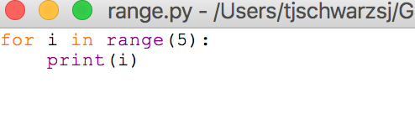
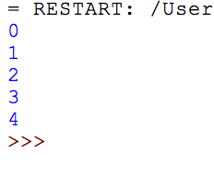
Repetition

Slide 6
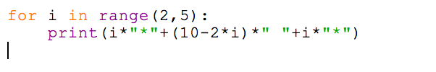
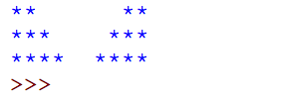
Repetition

Slide 7

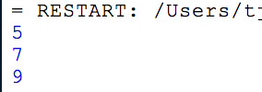
Repetition
You can add a third parameter to range in order to get the stride.

Slide 8

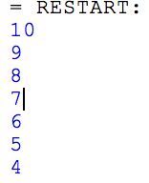
Repetition
This is interesting when you choose a negative stride, as it allows you to go backward

Slide 9
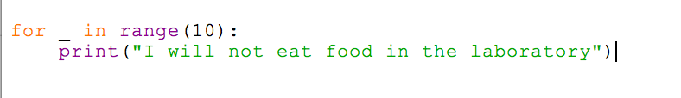
Repetition
Very often you only want to repeat a block n times
The pythonesque way of doing that is to use the underscore as the variable

Slide 10
Repetition
Do Activities 1, 2, and 3

Slide 11
Boolean Expressions
A boolean expression is either True or False
You can create Boolean expressions by
Starting out with the atomic values True / False
Use comparisons:
Equality: x==y
Inequality: x<3 x>=y**2 x!=“A”
Built-in functions:
string = “3.456”
string.isdigit()

Slide 12
Boolean Expressions
You can combine Boolean expressions with Boolean operators
and &&
or ||
not !
You can use either the symbolic or the literal version of the operand and also use parentheses
print(x<3 or x>5)
print(x<0 or not (x<4 and x>3))

Slide 13
Boolean Expressions
We use Boolean expressions most frequently for conditional execution
The construct if — boolean expression: Block executes the block if and only if the boolean expression is true
if x != 0:
print(2/x**2)

Slide 14
Boolean Expressions
We can use Boolean values in for loops.
This gives a truth table for the ^ (exclusive or) operator
print("A", "\t", " B", "\t", " A xor B")
print(40*"-")
for a in [False, True]:
for b in [False, True]:
print(a, "\t", b, "\t", a^b)

Slide 15
Boolean Expressions
A B A xor B
----------------------------------------
False False False
False True True
True False True
True True False

Slide 16
Boolean Expressions
Activity:
Use the preceding code to obtain truth tables for “and” and “or”

Slide 17
Conditional Execution
We can use a boolean expression that allows us to execute a block of statements conditionally
Prints out all numbers between 0 and 19 that are even
Recall that % is the modulus operator
for i in range(20):
if i%2==0:
print(i)

Slide 18
Conditional Execution

Slide 19
Conditional Execution

Slide 20
Conditional Execution

Slide 21
Conditional Execution

Slide 22
Conditional Execution

Slide 23
Conditional Execution

Slide 24
Conditional Execution

